Slide 1
Polymorphism
The Greek word polymorphism means one name, many forms.
Two types of Polymorphism in C++:
Static polymorphism: It can be achieved by using overloading. It is defined at compilation time (i.e., static binding).
Dynamic polymorphism: It can be implemented by using inheritance and implemented at runtime (i.e., Dynamic Binding) .

Slide 2
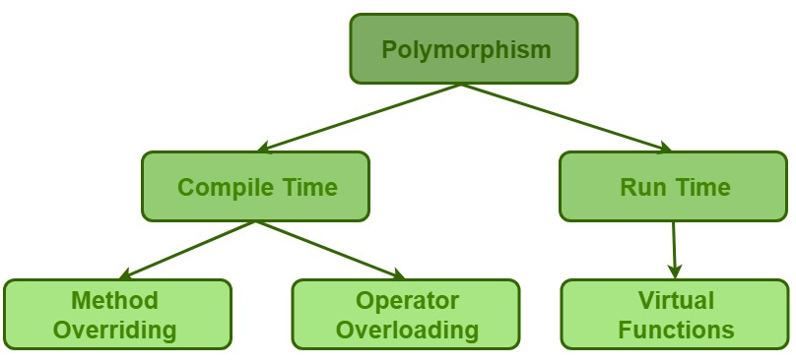
Polymorphism

Slide 3
Graphics Drawing Software, name these items?
shapes

Slide 4
Graphics Drawing Software Classes
Line
Properties:- X-Y Coordinates, Length, Color
Actions:- Draw Function, Change Color Function, Get Area Function.
Circle
Properties:- X-Y Coordinates, Radius, Color
Actions:- Draw Function, Change Color Function, Get Area Function.
Rectangle
Properties:- X-Y Coordinates, Width, Height, Color
Actions:- Draw Function, Change Color Function, Get Area Function.
Cylinder
Properties:- X-Y Coordinates, Radius, Height, Color
Actions:- Draw Function, Change Color Function, Get Area Function.
Triangle
Properties:- X-Y Coordinates, Length, Width, Color
Actions:- Draw Function, Change Color Function, Get Area Function.

Slide 5
class Line
{
protected:
int x,y;
public:
Line(int ,int );
void draw();
int GetArea (void);
};
Line::Line(int a,int b) {
x=a;
y=b;
}
void Line::draw( ) {
cout << “\n Line Drawing code”;
}
int Line::GetArea ( ) {
cout << “\nLine Area “; return 0;
}

Slide 6
class Circle: public Line {
protected:
int radius;
public:
Circle(int ,int, int );
void draw( );
int GetArea ( );
};
Circle::Circle(int a, int b, int c) : Line (a, b) {
radius = c;
}
void Circle::draw( ) {
cout << “Circle drawing code”;
}
int Circle::GetArea ( ) {
cout << “Circle area code”; return 0;
}

Slide 7
class Rectangle: public Line {
protected:
int Width, Height;
public:
Rectangle(int, int , int , int );
void draw(void);
int GetArea (void);
};
Rectangle::Rectangle(int a, int b, int c, int d) : Line (a, b ) {
Width = c; Height = d;
}
void Rectangle::draw() {
cout << “Rectangle drawing code”;
}
int Rectangle::GetArea () {
cout << “Rectangle area code”; return 0;
}

Slide 8
class Triangle: public Line {
protected:
int a_axis,b_axis,c_axis;
public:
Triangle(int, int , int);
void draw(void);
int GetArea (void);
};
Triangle::Triangle(int a, int b, int c) : Line (a, b ) {
a_axis= a; b_axis= b; c_axis=c;
}
void Triangle ::draw() {
cout << “Triangle drawing code”;
}
int Triangle ::GetArea () {
cout << “Triangle area code”; return 0;
}

Slide 9
int main ( )
{
Triangle t1 (3, 4, 5, 19 );
Circle c1 (3, 4, 5 );
Rectangle r1 ( 3, 4, 10 , 20 );
t1.draw ();
cout << “The area is “ << t1.GetArea ( );
c1.draw ();
cout << “The area is “ << c1.GetArea ();
r1.draw ();
cout << “The area is “ << r1.GetArea ();
return 0;
}
Shapes.cpp Demo

Slide 10
Pointers to Derived Classes
C++ allows base class pointers to point to both base class object and also all derived class objects.
Let’s assume:
class Base { … };
class Derived : public Base { … };
Then, we can write:
Base *p1; Derived d_obj; p1 = &d_obj;
Base *p2 = new Derived;

Slide 11
Pointers to Derived Classes (contd.)
While it is allowed for a base class pointer to point to a derived object, the reverse is not true.
base b1;
derived *pd = &b1; // compiler error

Slide 12
Pointers to Derived Classes (contd.)
Access to members of a class object is determined by the type of the handle.
What is a Handle:
The item by which the members of an object are accessed:
An object name (i.e., variable, etc.)
A reference to an object
A pointer to an object

Slide 13
Pointers to Derived Classes (contd.)
Using a base class pointer (pointing to a derived class object) can access only those members of the derived object that were inherited from the base.
This is because the base pointer has knowledge only of the base class.
It knows nothing about the members added by the derived class.
Notes:
A base class pointer can point to a derived class object, but we can only access base class member or virtual functions using the base class pointer because object slicing happens when a derived class object is assigned to a base class object. Additional attributes of a derived class object are sliced off to form the base class object.

